Slide 2
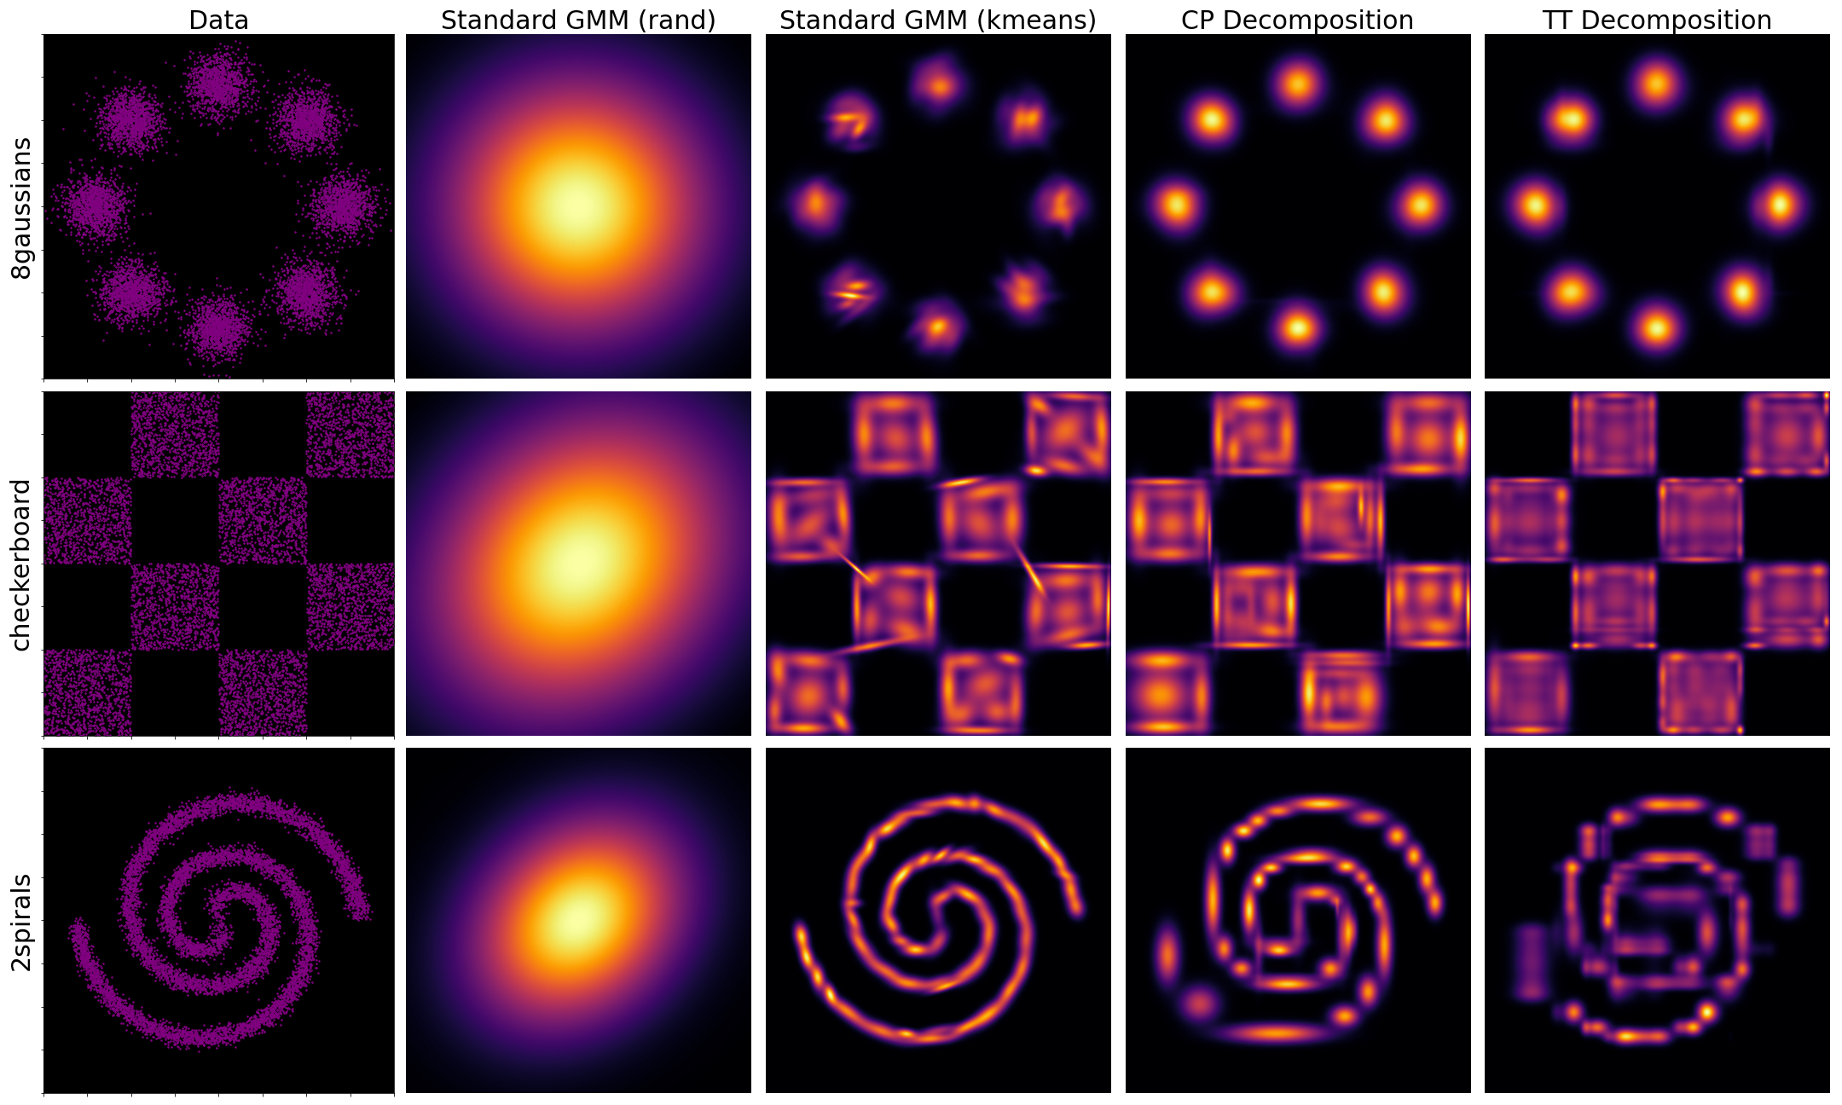
Visualization of TFDE models on toy data

Slide 3
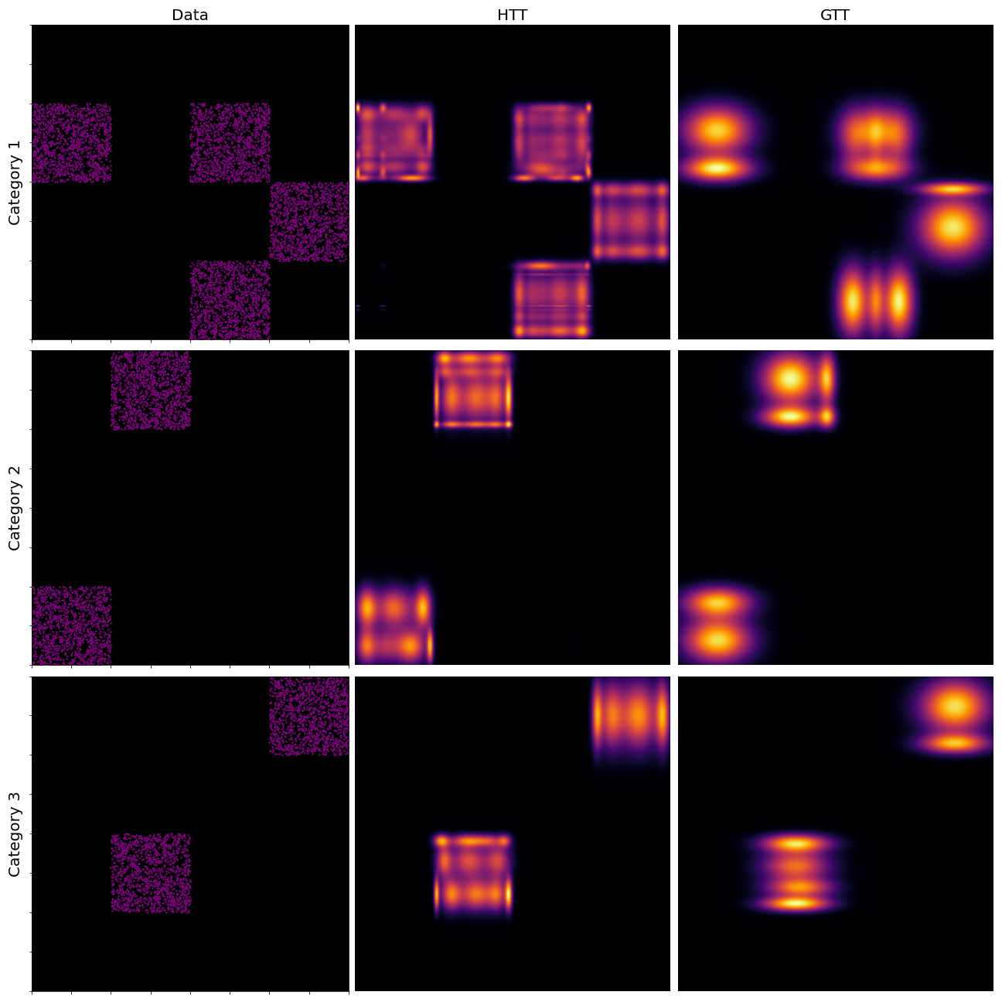
Visualization of heterogenous TFDE models

Slide 4
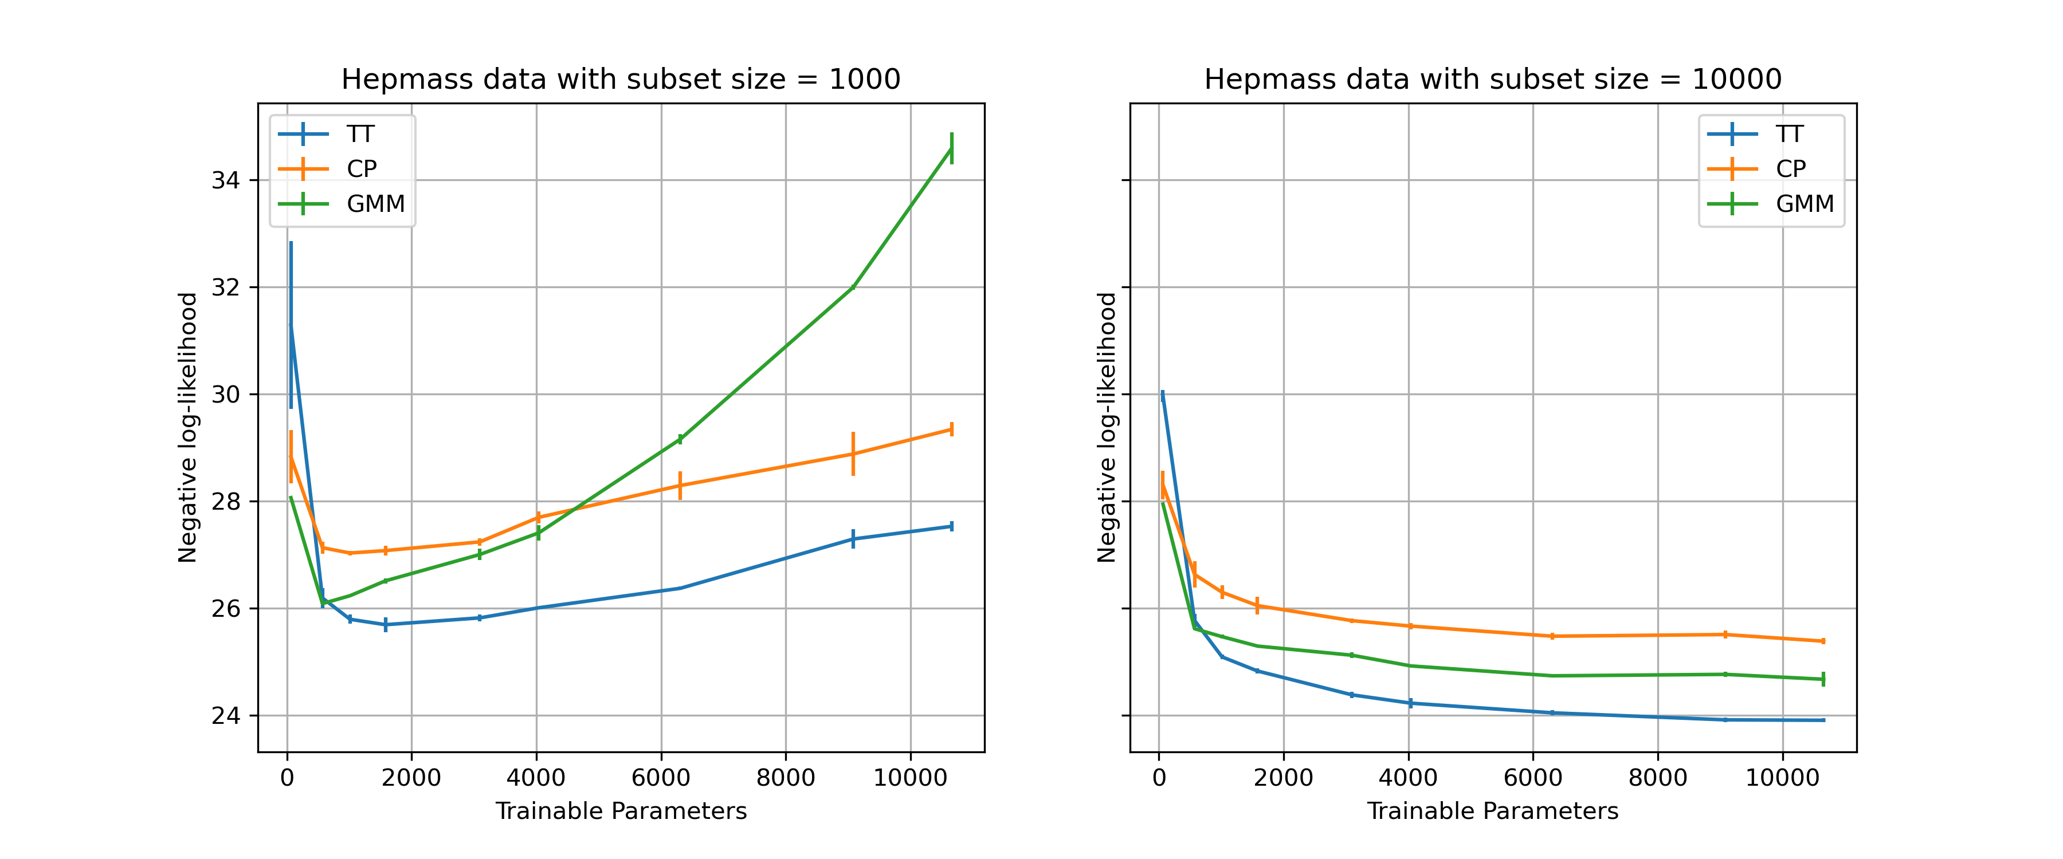
Model expressibility on data-subsets

Slide 5
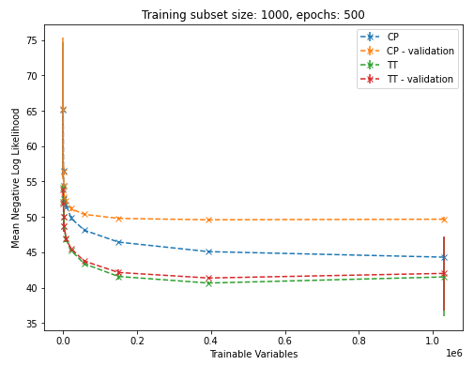
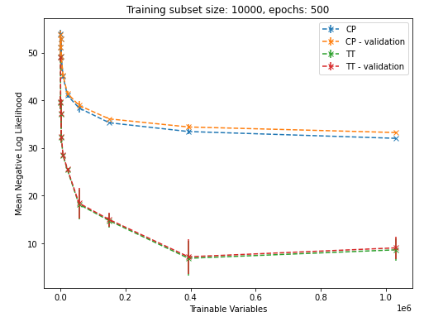
Heterogenous TFDE models adult data

Slide 6
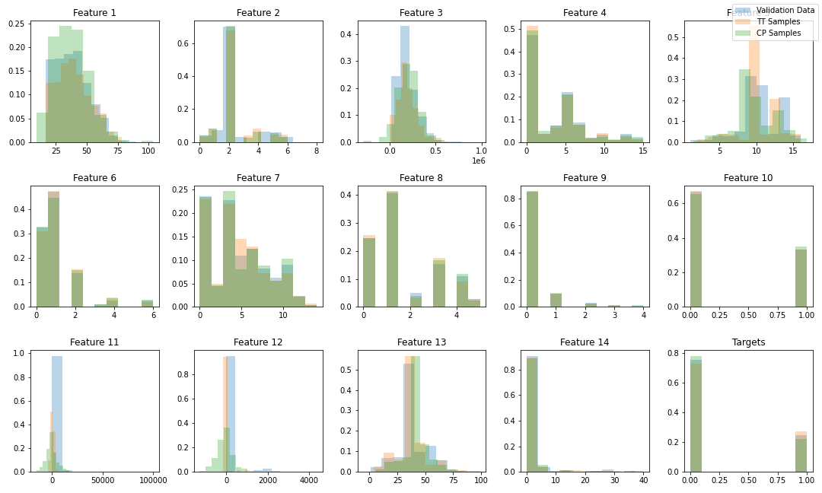
Data re-sampling on heterogenous data

Slide 7
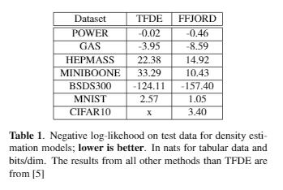
Results on ffjord data

